Slide 1

Dr. D. Y. Patil Institute of Technology, Pimpri
Department of Electronics & Telecommunication Engineering
Project Stage-I
Presentation on
“Design of Elevator Touchless Panel”
Group Members:
1.Pooja Birajdar
2.Mansi Housalmal
3.Vedant Todase
Under the Guidance of: Prof .Priyanka Patil

Slide 2
Title of the Project:- Design of an Elevator Touchless Panel

Slide 3
Objective of the Project:-
The main idea behind this project is to create an affordable, easy-to-build, and easy-to-use touch-free elevator "button".
Historically, the focus of elevator improvements has been on reliability and efficiency.
With COVID-19, These still important aspects have given way to a focus on touchless elevator technologies.

Slide 4
Problem Statement:-
Ensuring a safe work environment is key to the success of any organization.
When putting together a health and safety plan for your facility, adhering to governmental compliance requirements and reducing liability are a top priority.
Building elevators offer a unique challenge across the return to work landscape, as elevator buttons are among the most-touched surfaces in a multi-tenant facility, and the small, enclosed footprint of an elevator makes it difficult to social distance.

Slide 5
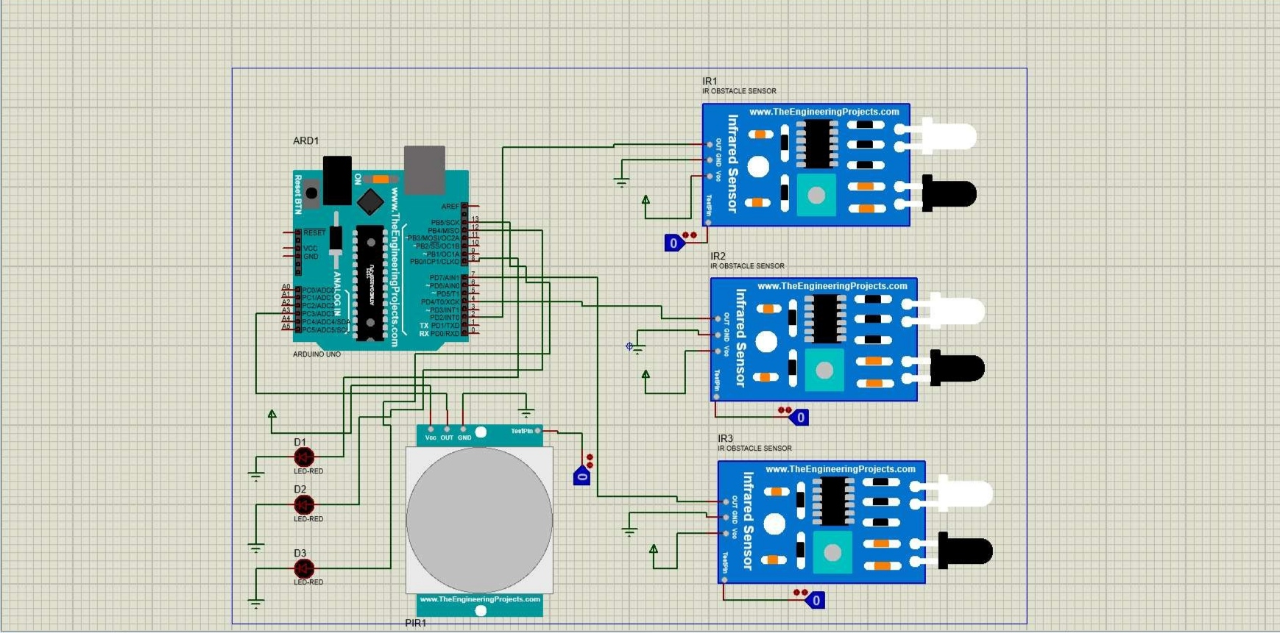
Circuit Diagram:-

Slide 6
Detail of Coding

Slide 7
Results:
Touch-free Elevator Operations.
It is easy to use.
Less chances to get infected by us of elevator buttons
Helps to reduce the risk of contracting the COVID-19

Slide 8
Conclusion
Touch-free Elevator Operations.
Fewer chances to get infected by use of elevator buttons
Updating the technology of your elevator system is another way to minimize liability in your building, but make sure your system is reliable and offers added protection like tailgating security and multi-factor authentication capabilities.

Slide 9
Paper Submission Detail

Slide 10
References :-
[1] C.E. Kandel, A.E. Simor and D.A. Redelmeier, Èelevator buttons as unrecognized sources of bacterial colonization in hospitals.È Open Med, vol. 8, no.3, pp.e81-e86, 2014.
[2] Canadian Institute for Health Information, "Spending," 2015. [Online]. Available: https://www.cihi.ca/en/spending-and-health-workforce/spending. [Accessed 4 April 2016].
[3] Tundong Liu; Xiaosheng Liao; Jianping Zeng. Design of Intelligent Elevator Remote Monitoring System Based on Ethernet. China, 2010
[4] Hyundai Elevator Co. Ltd, "New Yzer," 1 May 2014. [Online]. Available:http://www.hyundaielevator.co.kr/eng/about/PR/news/1189331_1881.jsp. [Accessed 5 April 2016].
[5]"Contact-free elevator button". China Patent CN 201310313137, 9 Oct 2013.
[6] Xibo Wang and Hongshuai Ge; Wenbo Zhang; Yingzhen Li. Design of Elevator Running Parameters Remote Monitoring System Based on Internet of Things. China, 2015.

Slide 11

Thank You

